Slide 1
Discourse Linguistics

Slide 2
Lectures 1-2
THE CONCEPT OF DISCOURSE
IN LINGUISTICS

Slide 3
Questions to discuss
1. Linguistic definitions of discourse. Components of discourse.
2. Discourse and related concepts.

Slide 4
Question 1
Linguistic definitions of discourse. Components of discourse

Slide 5
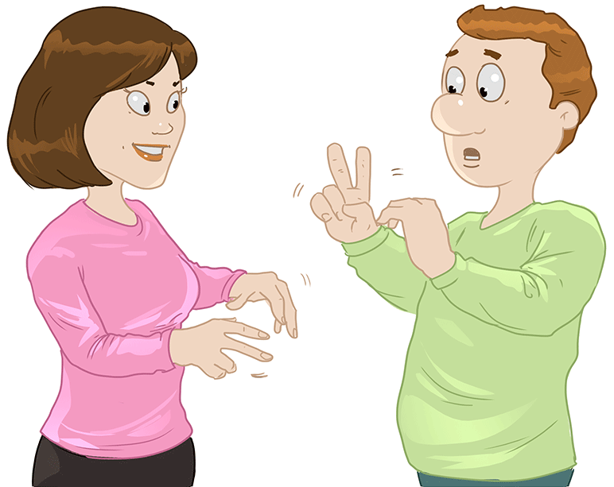

Slide 6
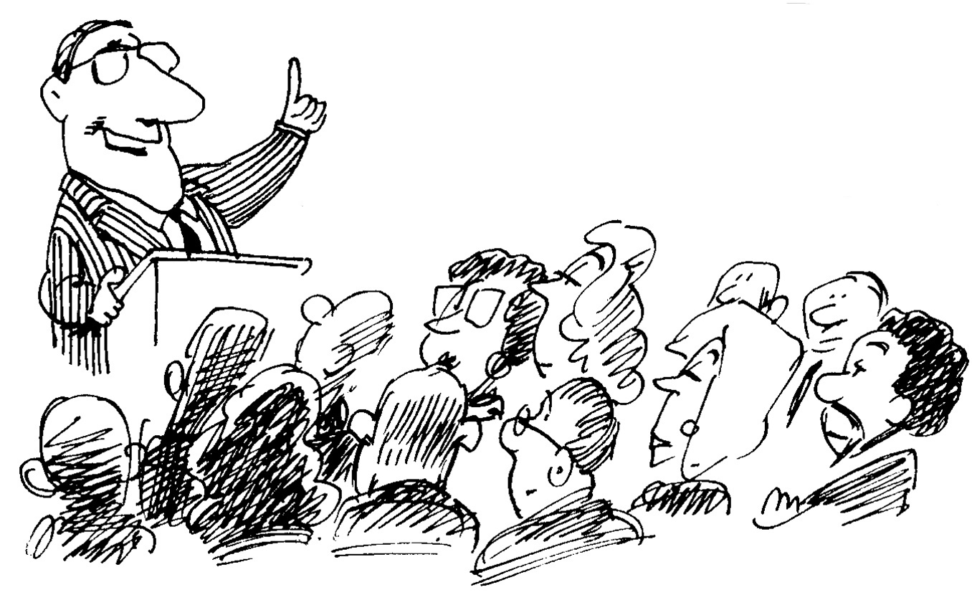

Slide 7
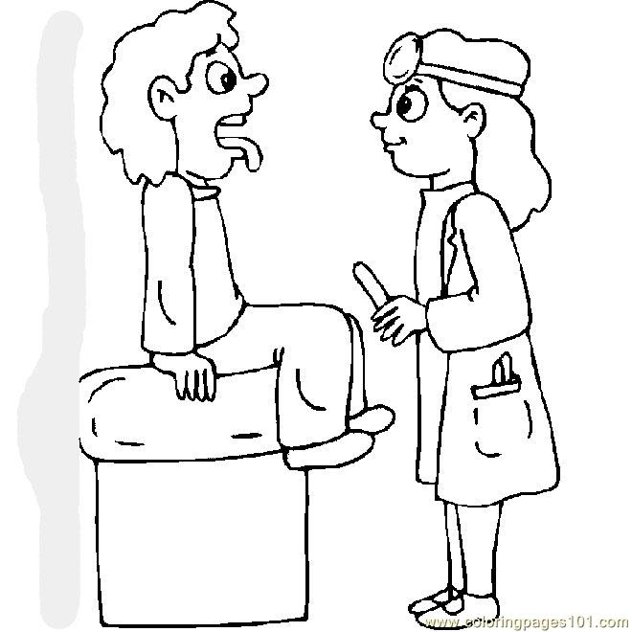

Slide 8
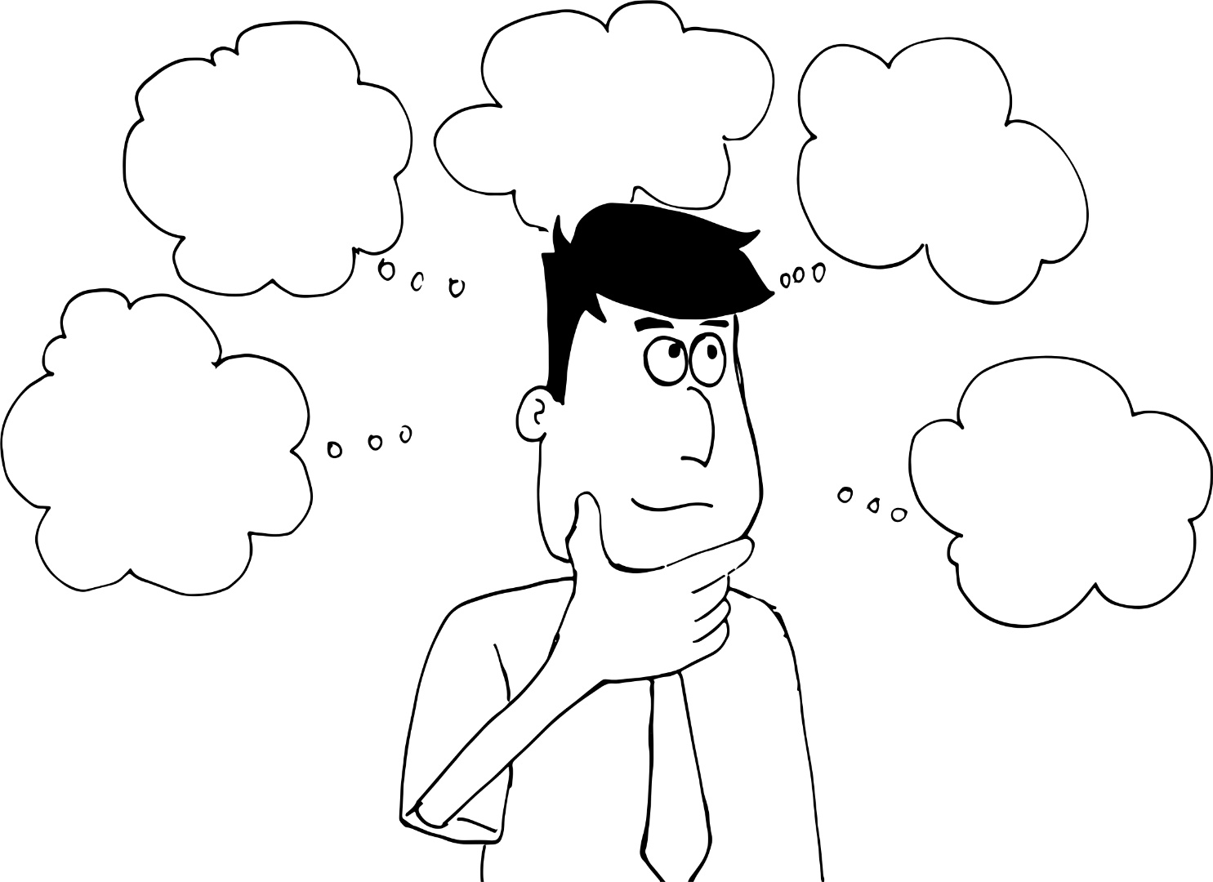

Slide 9


Slide 10
Let’s have a look at different definitions of the term “discourse” found in linguistics.

Slide 11
The concept of discourse is often defined through the concept of "speech”:
1) discourse is speech inside life (N.D. Arutyunova); discourse = speech+life
2) discourse is speech that belongs to the speaker (Émile Benveniste ); d. = speech +speaker
3) discourse is speech as a purposeful social action (M. Stubbs). D. = speech + social action

Slide 12
Discourse = speech + extralinguistic phenomena

Slide 13
In other words, in the definitions above, the term “discourse” is confined to the concept of speech in combination with extralinguistic factors.

Slide 14
At the same time, the concept of discourse is often defined through the concept of "text":
1) discourse is a complex communicative phenomenon that includes the text and extralinguistic factors (knowledge about the world, opinions, attitudes, goals, etc.) (V. V. Petrov and Y. N. Karaulov); discourse=text +extralinguistic factors
2) a discourse is a text taken as an event (N.D.Arutyunova); d. = text + event
3) a discourse is a spoken text (T. van Dijk). D. = text + speech

Slide 15
Discourse = text+ extralinguistic phenomena

Slide 16
These definitions show that a discourse is a text and extralinguistic background / context.

Slide 17
In some cases, the discourse is also defined through other concepts:
1) discourse is communication of people belonging to a particular social group (V. I. Karasik);
2) discourse is everything that is said and understood in some specific situation;
3) discourse is a language in its constant motion, absorbing a variety of historic periods, individual and social characteristics of both a speaker and the communicative situation in which communication occurs" (T. A. van Dijk);
4) discourse is a "communicative event in certain situations and certain socio-cultural conditions of communication" (S. I. Vinogradov);
5) discourse is a communicative activity which is situationally and socially predetermined and taking place in real space and time coordinates (T. N. Kolokoltseva).

Slide 18
Discourse = linguistic phenomenon(-a) + extralinguistic context (circumstances, events, participants and their intentions, etc.)
It’s a bit chilly in the room.

Slide 19
Types of extralinguistic context
social context is a specific situation, a specific social group (which encourages participants to communicate and determines their speech behavior)
2) cultural and historical context (cultural values of the people, historical epoch)
3) paralinguistic context (gestures and facial expression).

Slide 20
Thus, a discourse is a complex communicative phenomenon that includes two components – a linguistic component (i.e. some communicative phenomenon – speech, text, language, etc.) and some extralinguistic component (conditions and circumstances of communication).
The number and nature of the components depends on the position of the particular author.

Slide 21
Discourse is a system of communication that has a real and potential (virtual) dimension. In the real dimension, it is a field of communication practices, this is the current speech activity in a particular social context. It is a process and connected with real life and real time, and also results from spoken works (texts) in combination with linguistic, paralinguistic and extralinguistic factors. In the potential dimension, discourse is a semiotic space that includes verbal and nonverbal signs focused on serving this communicative sphere, as well as a thesaurus of precedent statements and texts. The potential dimension of discourse also includes an idea of typical models of speech behavior and a set of speech actions and genres specific to this type of communication (E. I. Sheigal)
Put this definition in a formula
Discourse = 1 + 2+ 3 …

Slide 22
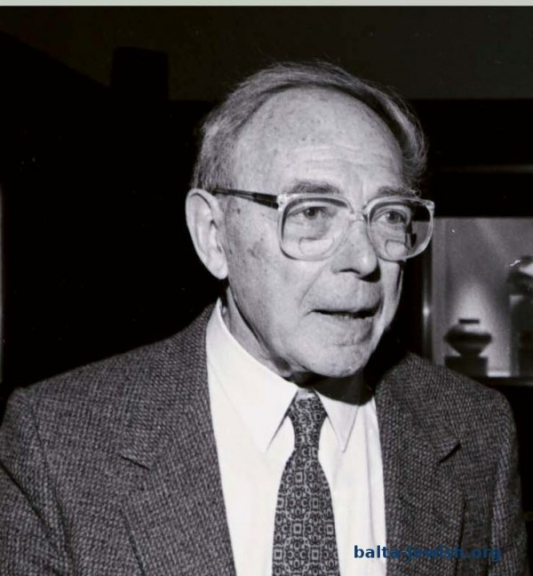
Zellig Harris (1902–1992)
Discourse is a sequence of sentences pronounced or written by one person (or more people) in a particular situation (1952, “Discourse Analysis”).

Slide 23
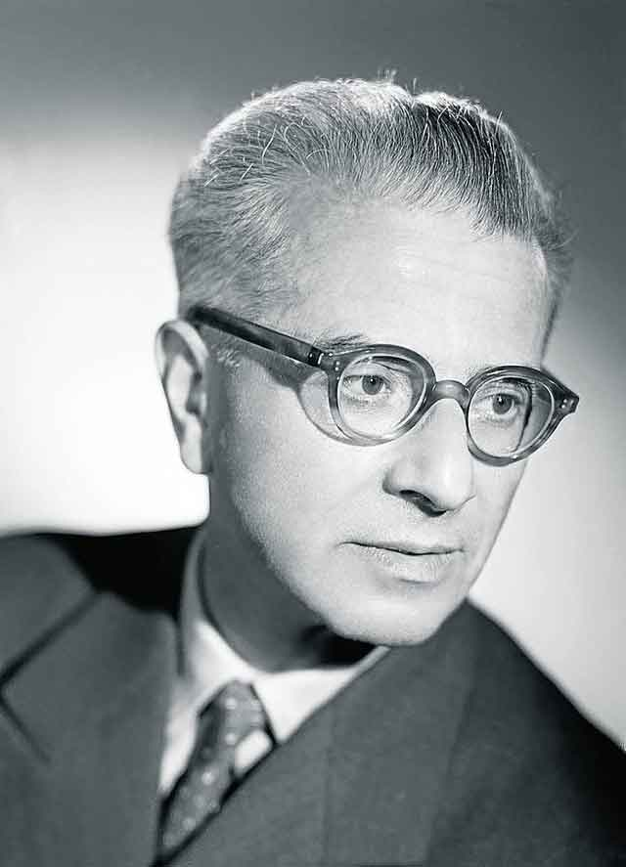
Émile Benveniste (1902–1976)
Discourse is speech belonging to the speaker
and is opposed to the objective narration (“recit”).

Slide 24
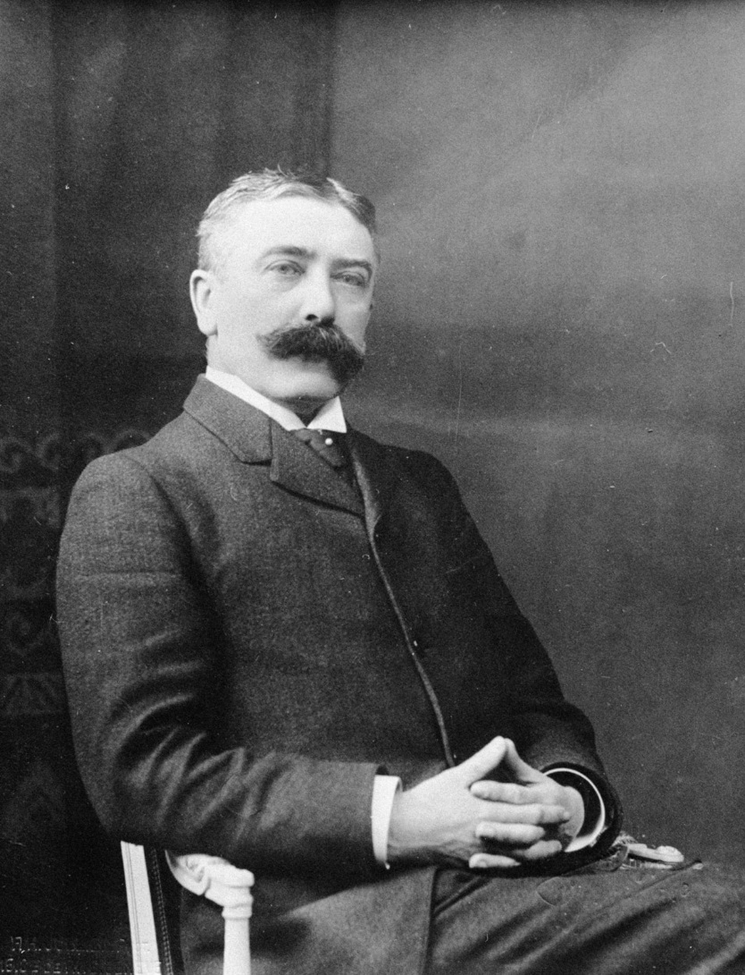
Ferdinand de Saussure (1857–1913)

Slide 25
Question 2
Discourse and related phenomena

Slide 26
As you know, the term of discourse is defined through the other terms: text, speech, language, and communication.
Let’s see what they mean in linguistics.

Slide 27
Discourse vs. Text
If we summarize the basic definitions of the concept of "text", we can say that the text is the result of communicative activity, its material embodiment (written or pronounced).
A text is a product of the speech-making process (so, a text is a product of discourse).

Slide 28
Discourse vs. speech
The term “speech” can be defined as the process of speaking and has a sound form or written form (so, speech is the process of actualization of discourse).

Slide 29
Discourse vs. Language
Language is a system of signs (symbols) which was not deliberately created and which is used for communication between people, for understanding reality and storing knowledge, etc. (so, a language is a means/tool for creating discourse).

Slide 30
And in this respect, the discourse is not confined to any of these concepts, but only includes them as its structural components.

Slide 31
Discourse vs. communication
So, the concept of discourse is very close to the concept of communication.
Communication is verbal and para-verbal interaction between people, one of the purposes of which is exchange of information.

Slide 32
Conclusion
1) there is no generally accepted definition of the term “discourse”,
2) discourse is a complex communicative phenomenon that includes a number of linguistic and extralinguistic components.

Slide 33
Ex. 1. Fill in the gaps with the following words: construct, sentence, utterance, limited, recipient, language
Patrik Serio defines discourse as:
- an equivalent to the word “speech, i.e. a particular …;
- a unit which is more than just … ;
- the influence of the utterance on the … ;
- units of the …, their speech representation;
- socially and ideologically … type of utterance, for example cookery discourse or academic discourse;
- theoretical…, used for exploring conditions of text production.

Slide 34
Ex. 2. Who is the author of the following definitions of discourse?
Zellig Harris
Teun van Dijk
E. Benveniste
F. de Saussure
A discourse is a sequence of sentences spoken or written by one person (or more people) in a particular situation.

Slide 35
Who is the author of the following definitions of discourse?
Zellig Harris
Teun van Dijk
E. Benveniste
F. de Saussure
Discourse is speech belonging to the speaker
and is opposed to the objective narration

Slide 36
Who is the author of the following definitions of discourse?
Zellig Harris
Teun van Dijk
E. Benveniste
F. de Saussure
Discourse is a language in its constant motion, absorbing a variety of historic periods, individual and social characteristics of both a speaker and the communicative situation in which communication occurs.

Slide 37
Ex. 3. Match the columns. 1. Text 2. Speech 3. Language 4. Functional style 5. Communicative event | A) a sublanguage used in a particular field of communication; B) the form of organization of communication and practical; C) a material product of the speech-making process; D) the process of speaking, articulating thoughts; (E) A system of symbols for communication of people, the knowledge of reality, and the storage of knowledge.

Slide 38
Ex. 4. Say what a discourse is (on the basis of the formula below):
Discourse = speech + language + text + extralinguistic context.

Slide 39
EX. 5. Compare the following definitions (Say what they have in common. Say in what way are they different).
1. G. A. Orlov examines the discourse as a natural speech, materialized in the form of oral or written speech acts, relatively complete in meaning and structure, the length of which is potentially variable: from syntagmatic (short story, conversations, descriptions, instructions, lectures, etc.)
2. Discourse is the line of intersection of the language and reality, vocabulary and experience (M. Foucault 1996).
3. Discourse is a text in terms of its context or communicative space (T. van Dijk, 1997).
4. Discourse is a verbalized speech-thinking activity, understood as a combination of process and outcome, with its own linguistic and extralinguistic plan (Red 2001).
5. Discourse is a coherent text produced in speech, but understood as an event.

